Slide 1
Capstone Project
Battle of the Neighbourhoods: Toronto

Slide 2
Problem Statement
Toronto is a bustling city full of opportunity for new businesses. While there is opportunity to be had, this has attracted many to start a business already and to unlock opportunity a new business will need to compete with the existing market.
Joe, a 35 old from Toronto has saved up working in a law firm and now would like to start his own business. It is crucial to understand where to locate his business to ensure he is not marginalised by the competition. Joe has a wide array of skills so happy to consider a range of different industries to enter.
The key questions Joe needs to answer are:
Which industry should he consider?
Where should Joe locate his first venue?
Are there any further expansion opportunities for the future?

Slide 3
Data which can solve this problem
Data set | Source | Key features | How this will be used
Toronto post code | https://en.wikipedia.org/wiki/List_of_postal_codes_of_Canada:_M | Postcode district and area information | To segment Toronto geographically into areas (postcodes) and return basic information of the area (postcode)
Geo-coordinates | Geocoder API | Location data | To enhance Toronto postcode data with geo co-ordinates
Foursquare venue API | https://api.foursquare.com/v2/venues/explore?<API call> | Venue types and locations | Identify existing business in Toronto, their location and type to help answer Joe's questions

Slide 4
Methodology
Data methodology
Import postcode data from Wikipedia and enhance with geo-coordinates from geocoder
Use the Foursquare API to gather the venue data for all postcodes
Group the data into postcode level dataframe and another at venue level for the analysis
Analysis key steps
Analyse which type of business is the most popular
Understand which districts have high / low penetration of the industry selected and how the venue types correlate with each other
Cluster to understand which is best location to start
Use K-means algorithm to understand the distinct groups of neighbourhoods.

Slide 5
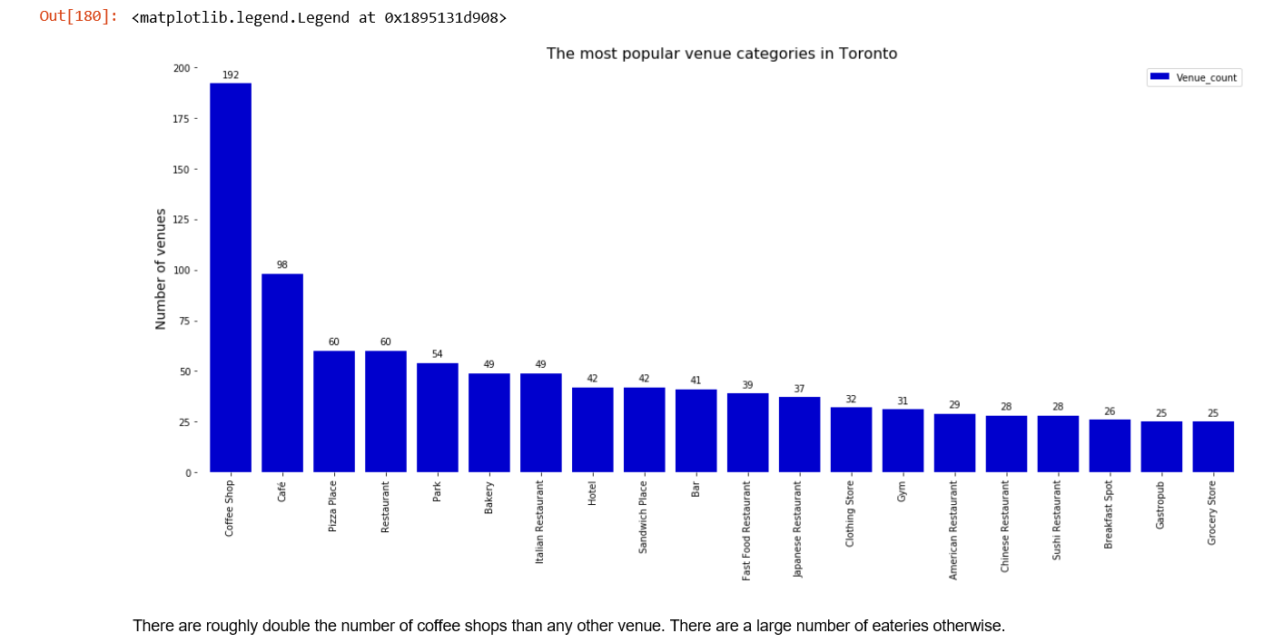
Results – Venue Category Rank
Coffee shops appear to be the most popular venue by far, with similar venue types also appearing in the top 20. This suggests a strong market for further venues.

Slide 6
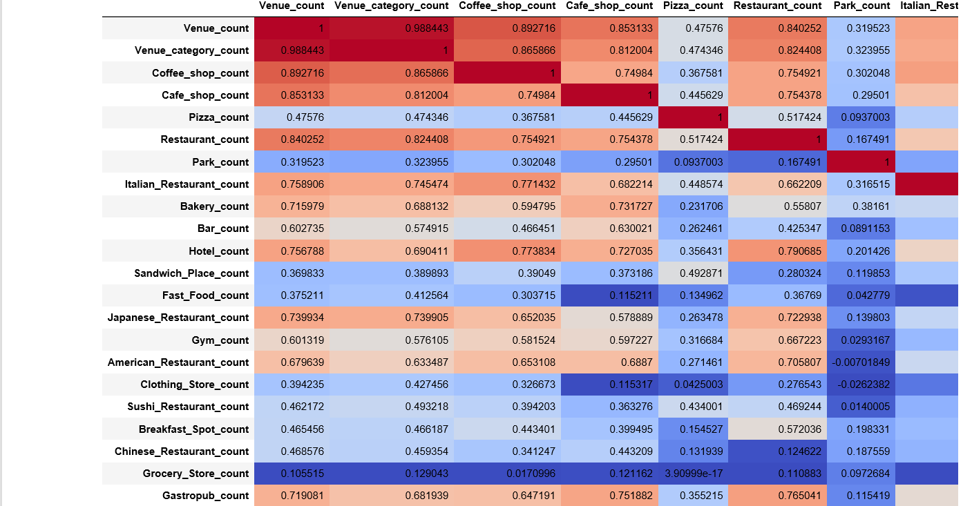
Results – Related Venues
Analysing the correlation between the top venue categories shows that cafes and restaurants are highly correlated with coffee shops. Whereas there is low correlation with parks, grocery stores and fast food venues

Slide 7
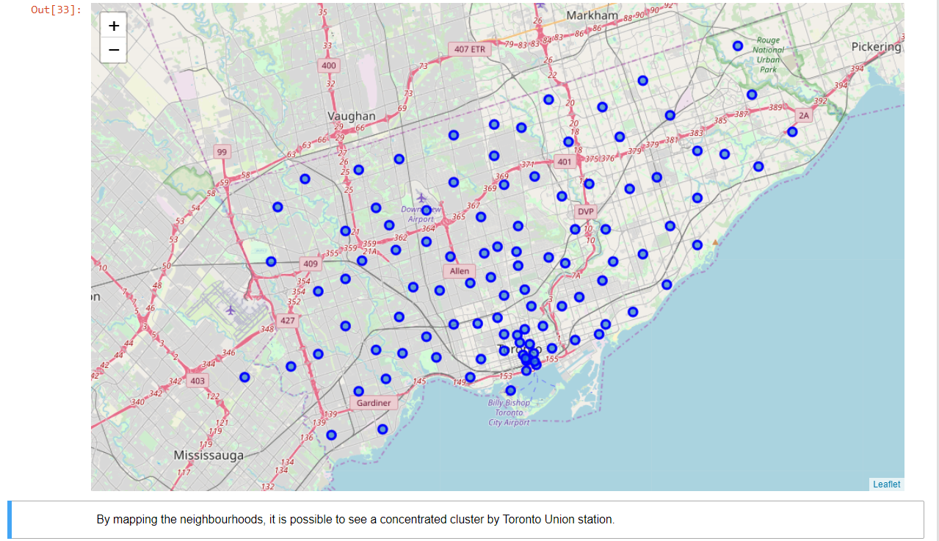
Results – Geographic understanding the neighbourhoods (1/2)
Plotting the clusters of neighbourhoods by using a geographical lens results in two highly concentrated neighbourhoods being returned – one near union station and another slightly north of this.
This appears to be a key area to consider for business setup given the density of these neighbourhoods.

Slide 8
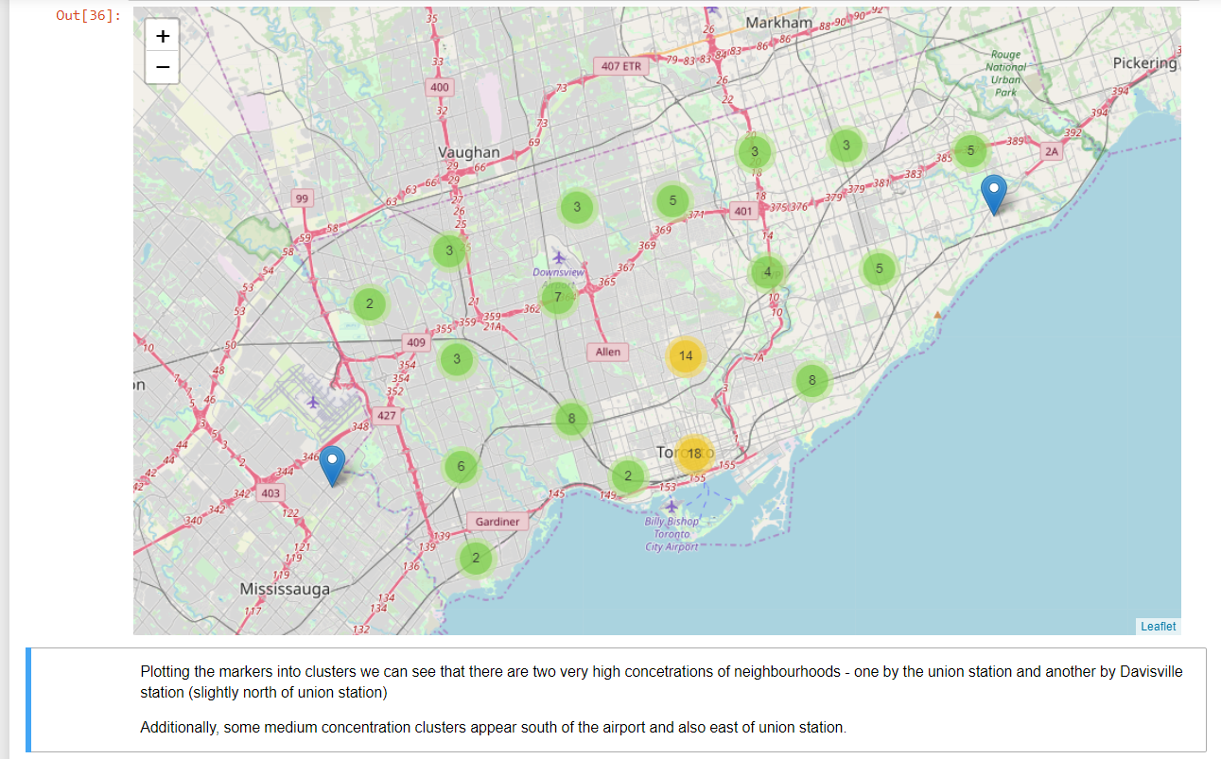
Results – Geographic understanding the neighbourhoods (2/2)
This becomes more clear when we plot the neighbourhoods by geographical clusters.

Slide 9
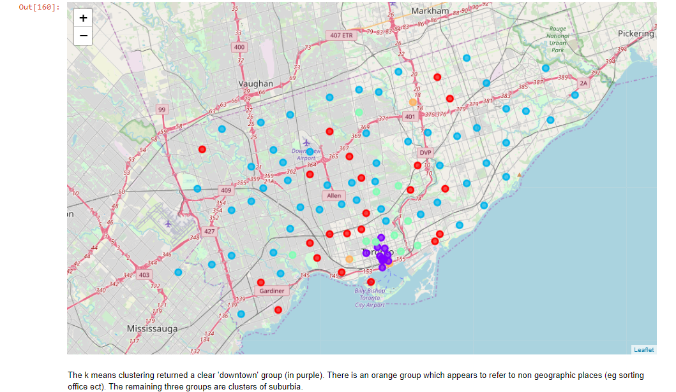
Results – Venue analysis for Toronto Neighbourhoods
The clustering of neighbourhood by venue characteristics validates the downtown clusters previously seen (purple). It also reveals the distinct suburb groups which are shown in blue, red and orange. The green segments highlight neighbourhoods with inner suburbia characteristics.

Slide 10
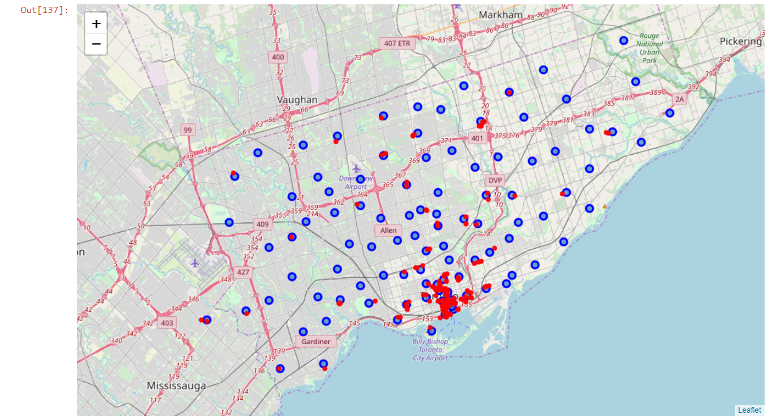
Results – Understanding the location of existing coffee shops and similar venues (1/2)
Existing coffee shops appear concentrated around the downtown area.

Slide 11
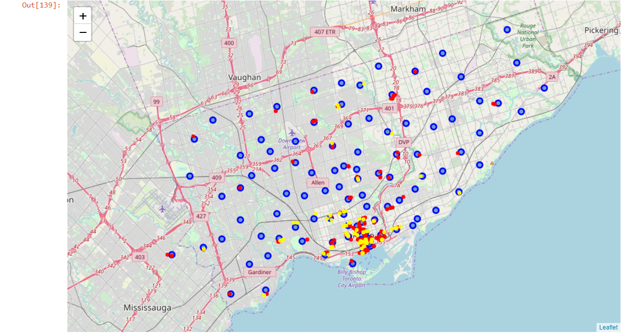
Results – Understanding the location of existing coffee shops and similar venues (2/2)
When adding related businesses to this picture, the same distribution is seen. The yellow dots represent café venues.

Slide 12
Discussion & Recommendations
The most popular venue type by far is the coffee shop, and this is the recommended market for Joe to enter. Existing businesses are concentrated geographically, so there remains opportunity in this market.
Location wise, setting up downtown initially where there is high demand would be the recommendation from the analysis on the data. Joe should focus on where there is less competition, so locations where there are higher numbers of park, grocery store or fast food venues.
The future market opportunities look good – once Joe has cracked the downtown market, there is also the inner suburbia and multiple suburbia markets to tap into.

Slide 13
Conclusion
Joe now has a recommendation to focus on from his original 3 wide ranging questions. Opening a business is a major undertaking and as such, he needs to undertake further analysis and financial modelling to validate the robustness of the opportunity surfaces. Further investigation of the competitor service needs to be completed – ie price points and product offering. Joe should then decide whether to compete on product, price or service depending on the opportunities and competition levels.
Data analysis which could inform this would be looking at reviews and business revenue / turnover.

